Slide 1


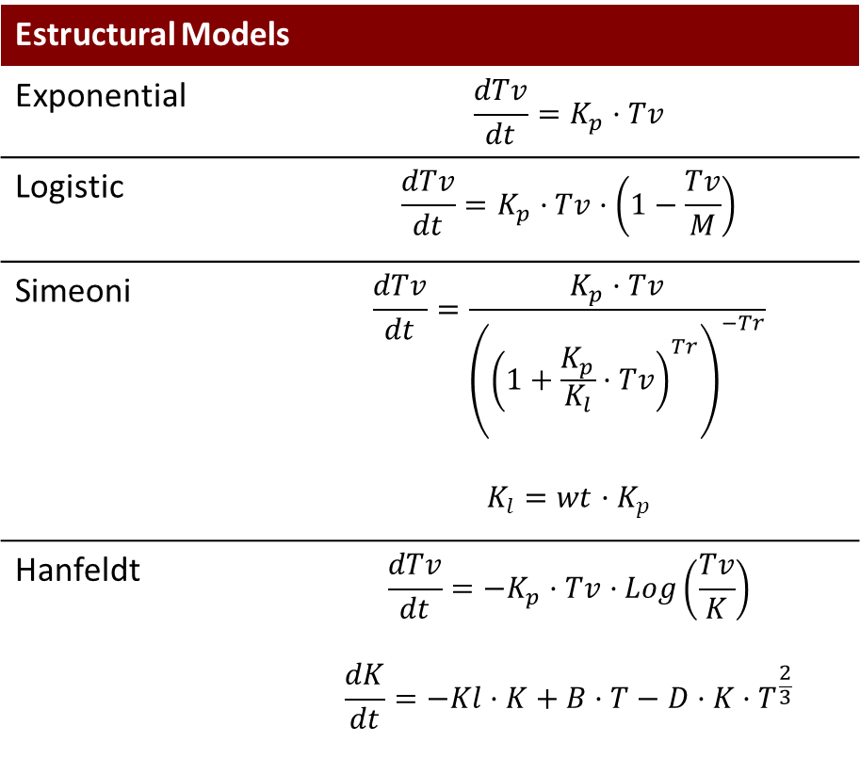
Exploring Inter-study variability in the context of modeling unperturbed xenograft data
M Garcia-Cremades¹, V Mangas-Sanjuan¹, IF Troconiz¹, G Mo², C Pitou², PW Iversen³, JE Wallin²
¹ Department of Pharmacy and Pharmaceutical Technology, School of Pharmacy, University of Navarra, Pamplona, Spain
² Global PK/PD & Pharmacometrics, Eli Lilly and Company ³ Lilly Research laboratories, Eli Lilly and Company
BACKGROUND
  The magnitude of the inter-study variability in TS0 and Kp were estimated between 20-30% and was in the same range compared to the inter-animal variability (10-42%) (Table IV). In Figure III the pc-VPC for each lung tumour-type cell line using the final Simeoni’s model is shown. Figure IV represents the proliferation rate parameter of each cell line and the overall variability estimated based on the number of studies performed.
  Pharmacokinetic/Pharmacodynamic characterization of anti-tumor drug effects using xenograft studies is an important process during early stages of oncology drug development. A common feature in those studies is the presence of experimental variability (i. e., same tumor cell lines), and it is not uncommon to note discrepancies in model-related parameters and response outcomes (i.e., % tumor growth inhibition). Proper characterization of different levels of variability (individual and experimental) may facilitate interpretation of individual experiments, as well as optimal design.
  The objective of this work is to quantify the extent and the impact of inter-study variability on the model parameters reflecting initial tumor conditions (TS₀) and proliferation rate (λ₁).
  Table IV. Models for unperturbed tumour growth
 | Cell Lines
Parameter | H441 | A549 | Calu-6 | H1650 | H1975 | H2122 | HCC827
TS₀ (mm3) | 92.1 | 65.1 | 90.3 | 74.2 | 103 | 142 | 61.7
KP (days⁻¹) | 0.0435 | 0.0548 | 0.0971 | 0.0546 | 0.137 | 0.153 | 0.118
SCL | 4180 | 3920 | 3150 | 1730 | 2530 | 455 | 621
w²_{TS0} (%) | 22 | 17 | 15 | 13 | 11 | 18 | 38
w²_{KP} (%) | 42 | 16 | 31 | 17 | 18 | 23 | -
w²_{SCL} (%) | - | - | - | - | - | - | -
w²_{TS0_st} (%) | 28 | - | - | - | - | 16 | -
w²_{KP_st} (%) | 28 | - | - | - | - | - | -
w²_{SCL_st} (%) | - | - | - | - | - | - | -
Residual error (log mm³)* | 0.23 | 0.189 | 0.152 | 0.191 | 0.212 | 0.168 | 0.227
METHODS
  Longitudinal tumor volume data from animals (n=239) that received saline administration were used for this analysis. The selected analysis dataset represent different lung cancer tumour cell lines (n=7). For each type of cell line the number of experiments varied from 1 to 13 (Table I). All the analyses were performed with NONMEM 7.3. Different structural models were fit to the data to characterize the unperturbed tumour growth kinetics (Table II). Once the base population model was selected for each cell line, the study variable was incorporated into the model either as a non-ordered categorical covariate, or as second level of variability through the $LEVEL functionality available in NONMEM 7.3 (Figure I).
  TS0 corresponds to base tumour volume, Kp represents the proliferation rate constant, SCL is a threshold tumor volume at which the tumor growth switches from exponential to linear. W2 corresponds to the inter-animal variability of each parameter, being w2Parameter_st, the interstudy variability associated to each parameter with the LEVEL function
  Table I. Raw data
Lung Cancer Cell Line | Nº Studies | Strain | Nº Mice
H441 | 13 | Athymic nude | 119
A549 | 2 | CB-17scid | 15
Calu-6 | 2 | CD-1 nu/nu | 25
H1650 | 1 | Athymic nude | 8
H1975 | 1 | Athymic nude | 8
H2122 | 6 | Athymic nude | 56
HCC827 | 1 | CB-17scid | 8
Tumour growth data
Typical Effects
Structural model
Random Effects
Non-ordered categorical covariate
TVKPRL=θ₁
IIVKPRL=θ₂
IF(STUDY.EQ.2) IIVKPRL=θ₃
…………………….
IF(STUDY.EQ.N) IIVKPRL=θ_{N}
KPRL=TVKPRL x EXP(ETA(1) x IIVKPRL)
$OMEGA 1 FIX
$LEVEL functionality
KPRL=θ₁ x (EXP(ETA(1) +ETA(N)
$OMEGA 0.3
………………..
$OMEGA 0.1
$LEVEL STUDY=(N[1])
  Table II. Models for unperturbed tumour growth
Estructural Models
Exponential | $$\frac{dTv}{dt}=K_{p}·Tv$$
Logistic | $$\frac{dTv}{dt}=K_{p}·Tv·\left(1−\frac{Tv}{M}\right)$$
Simeoni | $$\frac{dTv}{dt}=\frac{K_{p}·Tv}{{\left({\left(1+\frac{K_{p}}{K_{l}}·Tv\right)}^{Tr}\right)}^{−Tr}}$$ $$K_{l}=wt·K_{p}$$
Hanfeldt | $$\frac{dTv}{dt}={−K}_{p}·Tv·Log\left(\frac{Tv}{K}\right)$$ $$\frac{dK}{dt}=−Kl·K+B·T−D·K·T^{\frac{2}{3}}$$
  Figure I. Modelling workflow.
  Figure III. Model evaluation. Prediction corrected Visual Predictive Check for each lung cancer tumour cell lines.
RESULTS
  The unperturbed tumor growth model proposed by Simeoni et al.[1], provided a fair description of the data in all the seven different tumor cell lines. Including the study variable as second level of variability was significant (p<0.001) in those studies with more than three repeated experiments. Table 2 shows the -2LL for each developed model in those cell lines where inter-study variability was statistically significant (Table III).
  Table III. Models for unperturbed tumour growth
Model Structure | H441 [-2LL] | H212 [-2LL]
Base model | -2972 | -1145.749
Differences at typical behavior on T0 & KP | -3098 | -
Mixture Model (Two populations in TS0) | -2979 | -
Mixture Model (Two populations in KP)* | -3044 | -1148
$LEVEL en TS0 | -2993 | -1158
$LEVEL in TS0 & KP | -3036 | -1162
Mixture Model (KP) & $LEVEL (TS0 & KP) | - | -
H441
H2122
  Figure IV. Estimated proliferation rate parameter for each cell line and different tumour types. The size of the circle represents the overall parameter’s variability and the color intensity the number of studies used for parameter estimation.
CONCLUSION
  This analysis shows that inter-study variability is present in typical xenograft experiments with a moderate magnitude and can be detected with precision in cases with at least three repeated experiments. Current available tools in Pharmacometrics allow proper handling of study effects beyond the covariate effects. Ongoing research focuses on the role of study effects in the perturbed growth model, and its similarities across different types of cancers.
Simulation with interindividual, interstudy & residual variability
Simulation with interindividual & interstudy variability
Simulation with interindividual variability
Reference
  Figure II. Levels of model variability . Simulations of Tumour growth (95%), for those cell lines including interstudy variability, taking into account (a) interindividual, interstudy and residual variability of the variability (green shadow profile), (b) interindividual and interstudy variability and (c) interindividual variability.
  Simeoni M, Magni P, Cammia C, De Nicolao G, Croci V, Pesenti E, Germani M, Poggesi I, Rocchetti M. Cancer Research 64: 1094-101.

